Slide 1
Microgravity Washing Machine Project Update

Slide 2
Personal Background
2019-2020 NASA HUNCH Design Competition Semi-Finalist from Glenelg High School
Currently studying for B.E. Naval Architecture with USCG Unlimited Engine License at SUNY Maritime College, going into senior year

Slide 3
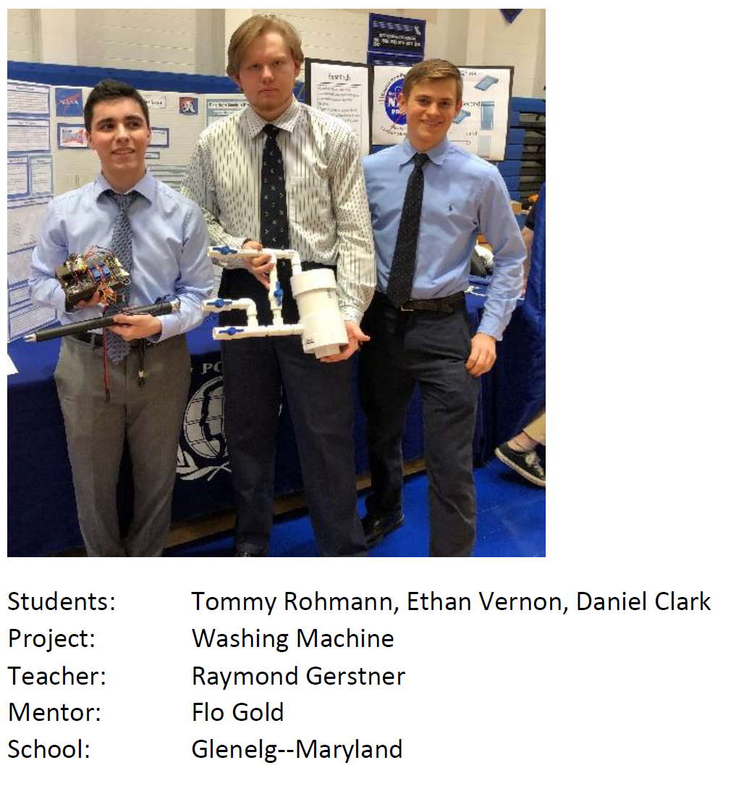

Slide 4
Microgravity Press Washing Machine
Utilize a sealed piston to compress and decompress a clothing item. This action has two main functions:
Compress the clothing to facilitate agitation
Act as a pump to manipulate fluid throughout the wash process

Slide 5
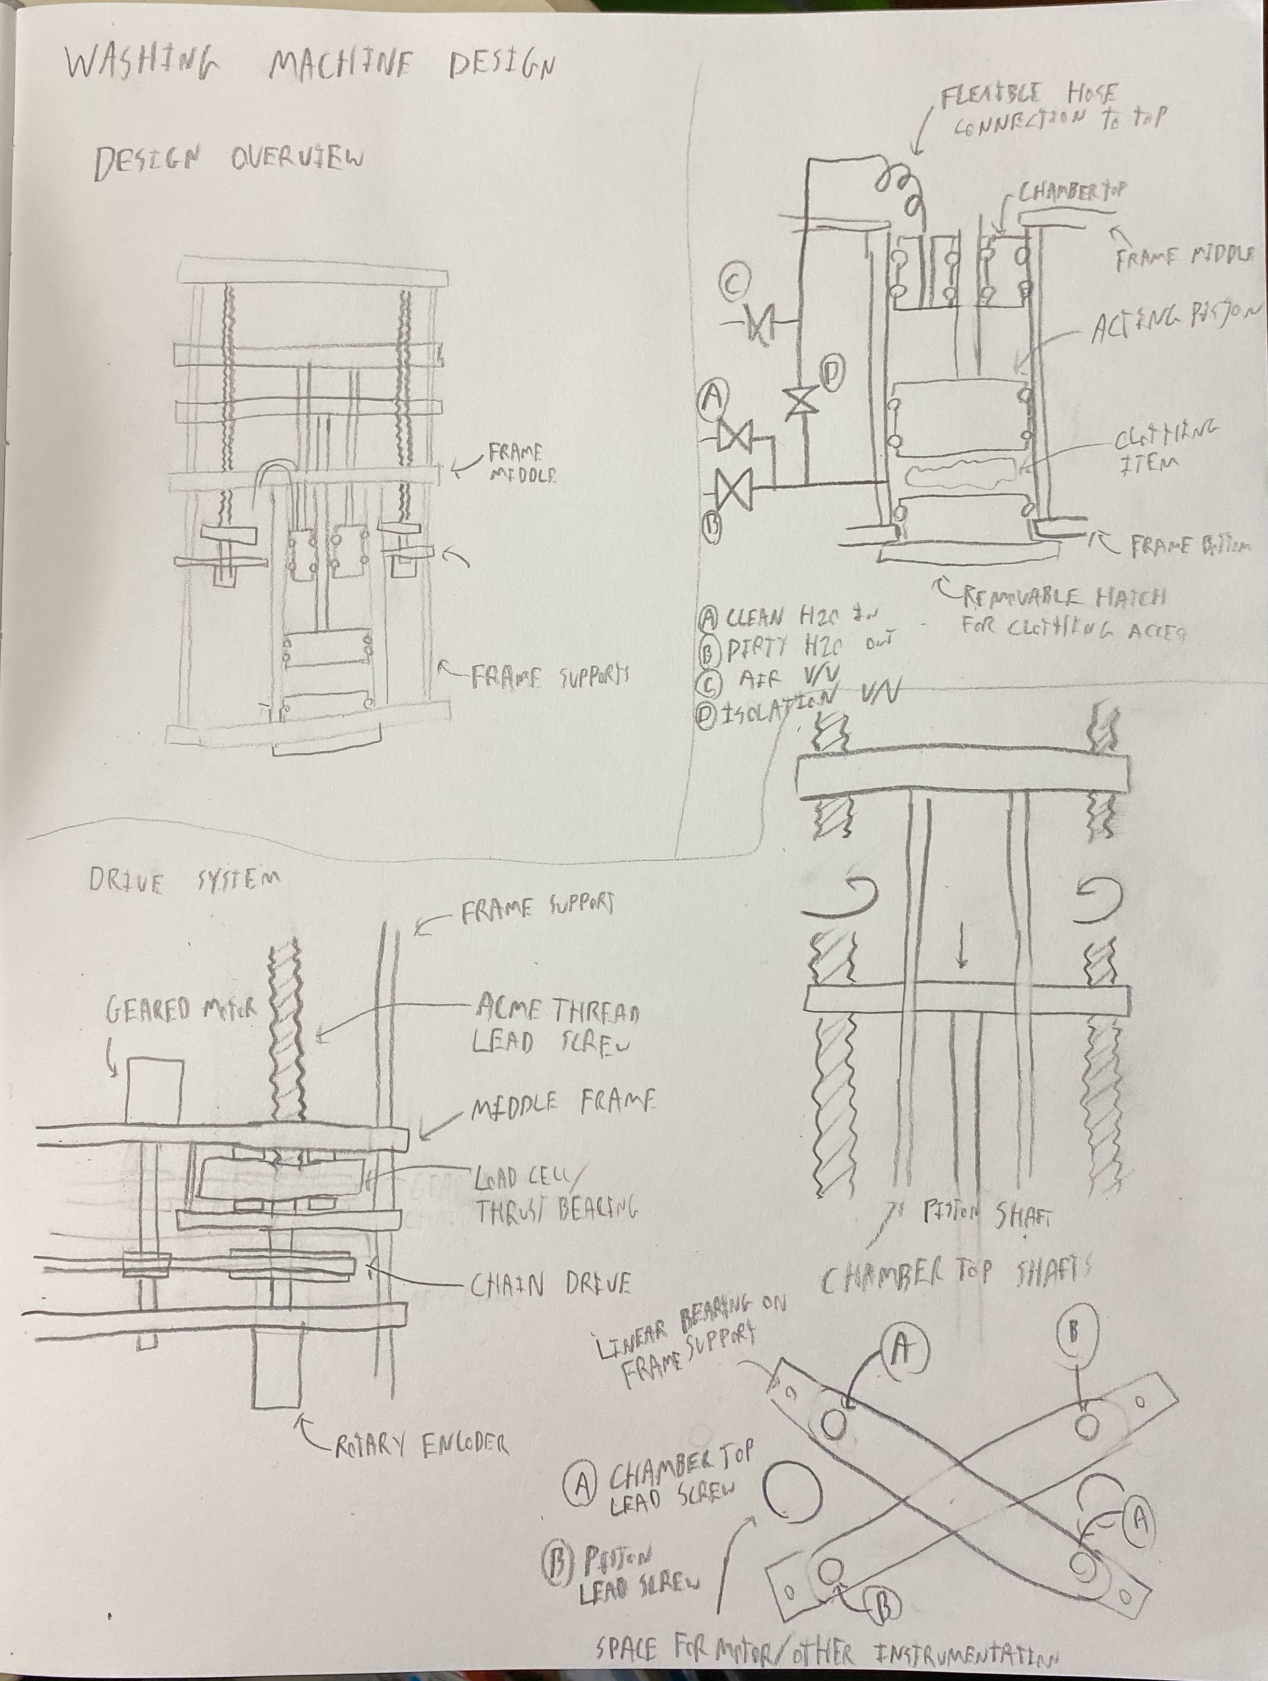
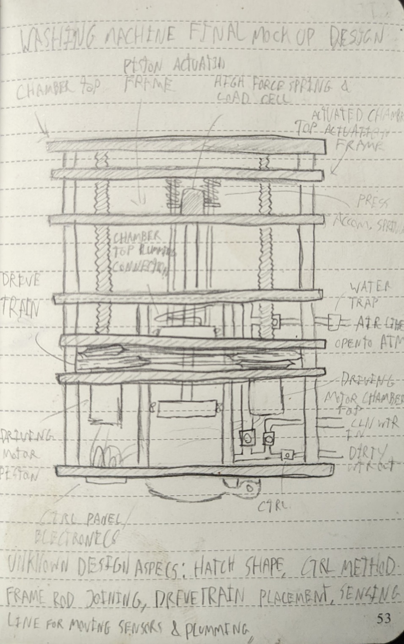

Slide 6
Design Advantages
Segregation of dissimilar fluids
Simple Mechanism and wash process
Small
Rigid Assembly

Slide 7
Progress Since NASA HUNCH 2019-2020
1st Prototype: More to demonstrate design features groupmates did not believe would work. Initially getting
2nd Prototype: Prototype designed to test design efficacy disregarding project constraints
Prototype Design Testing: Determine the effectiveness of the press wash process

Slide 8
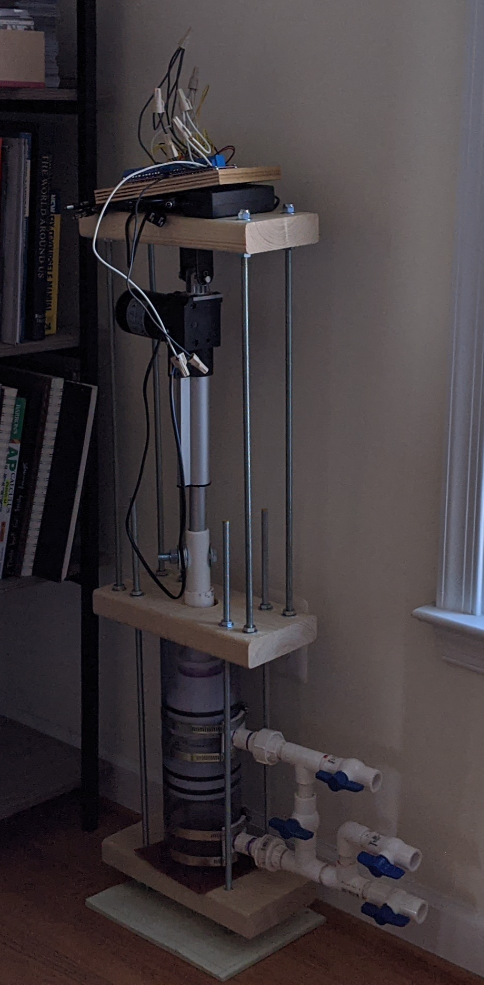
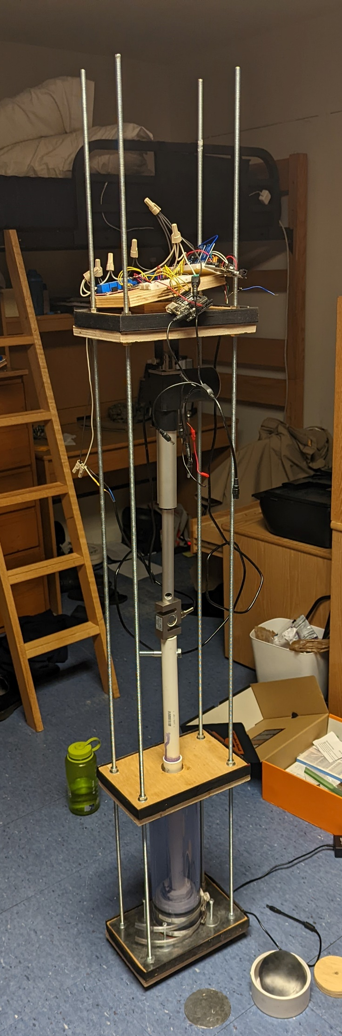
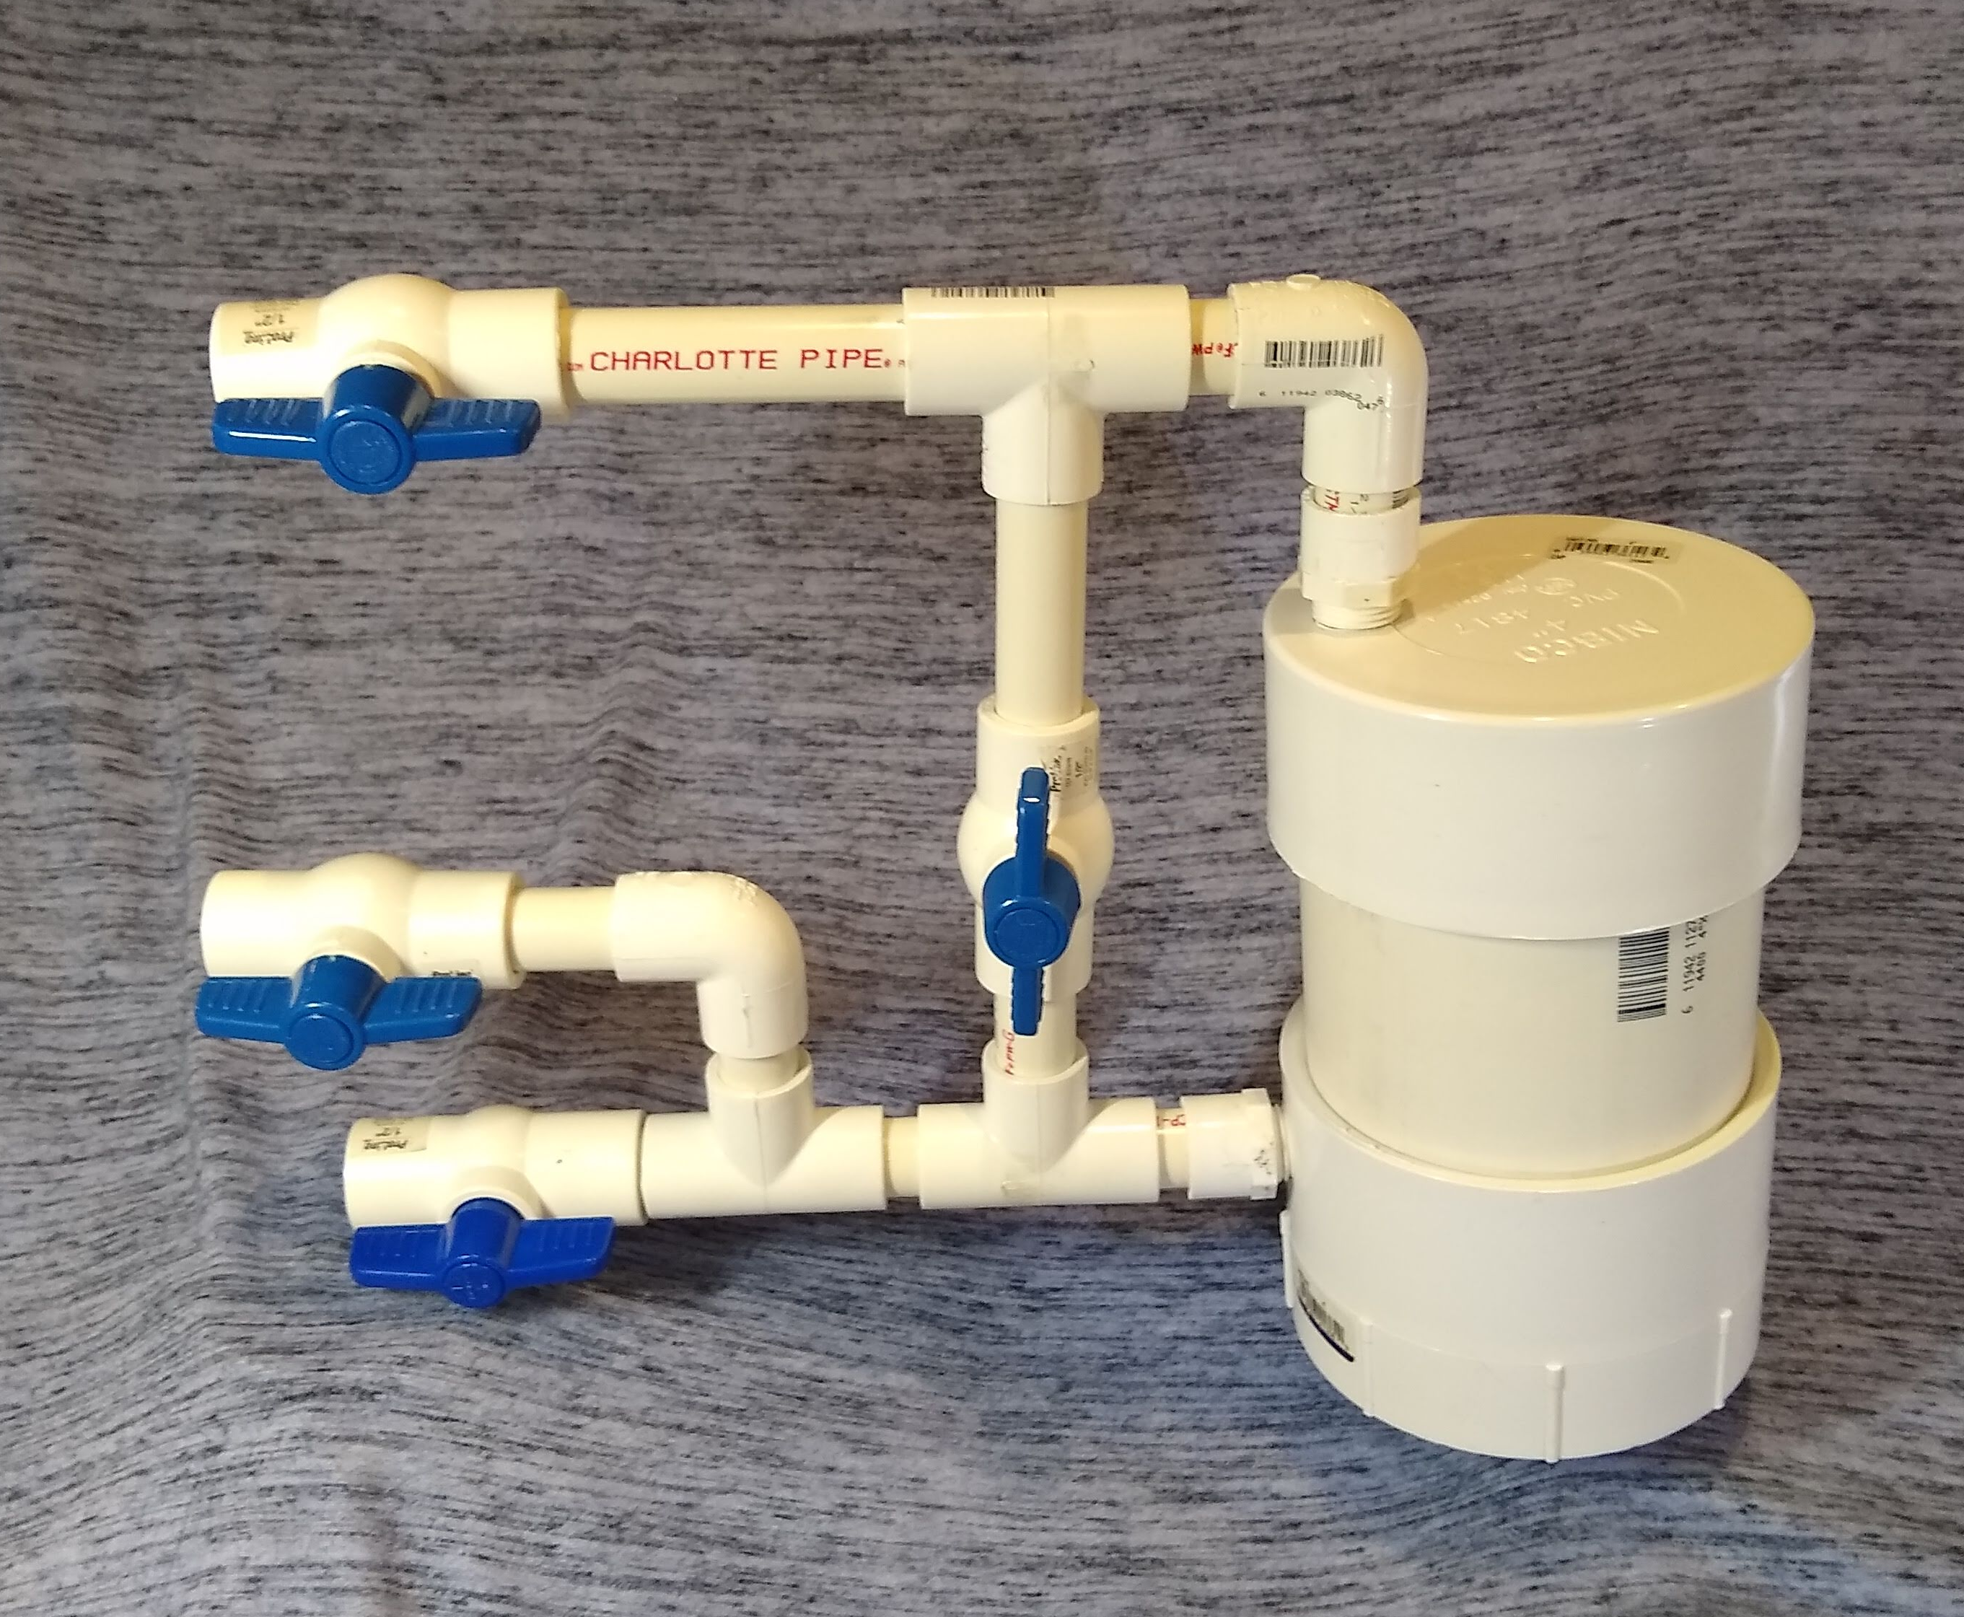
Pictured are the prototypes made in chronological order from left to right. The first is a mock-up made during the NASA HUNCH Design Competition.

Slide 9
What Has Changed Since Starting the Project?
Project Criteria and Constraints
- 1000 mL of water allowance for washing 1 clothing
Detergents for space became a possibility
Washing Machine Design
Compression found to be instrumental to agitation
Orientation of washing machine components

Slide 10
Design Process for Prototype
Multiple parts of the design can be built independently from other design aspects, these include:
Frame and structural assembly
Drive system for the pistons
Electronic control system
System piping

Slide 11
Plans Moving Forward
At least finish and test current prototype
Original goal was to finish the prototype this Summer, but this does not appear to be a feasible goal due to schedule changes

Slide 12
What is Needed for This Project to Move Forward
Time working on the project. Currently I am working on the project in my free time between school, internships, and other obligations, so progress will be slower than I would like for the next year.
Consultation on design features, washing machine testing procedures, criteria updates, prototype creation, and more
Assistance procuring needed components for the washing machine if the project is continued

Slide 13
Additional Files to Go Over
For more information regarding the subjects of this slideshow can be found in the attached document. All project work is being stored on GitHub. To access the repository, follow this link:
https://github.com/tommyrohmann/Microgravity-Press-Washing-Machine

Slide 14
Thank you!
https://github.com/tommyrohmann/Microgravity-Press-Washing-Machine/tree/main
tommyrohmann@gmail.com

